Slide 1


Hii, IamSIDDHIKA
Welcome to Power BI Series
Part -37

Slide 2



Today Content
We focus only on the most used and important Dax Functions
I’m soo Excited.
Are you ready guys?
Meet DAX
COMMON FUNCTION CATEGORIES
5. TABLE MANIPULATION FUNCTIONS
ADDCOLUMNS SUMMARIZE

Slide 3

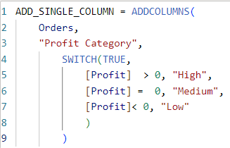

ADDCOLUMNS
The ADDCOLUMNS function in DAX allows you to add new columns to a table. These new columns are calculated based on existing data in the table.
Check next
Example also
Syntax
ADDCOLUMNS(<table>, <name>, <expression>[, <name>, <expression>]…)
Here just i’m taking for example to understand.
_{Example} You have a table named Orders with columns Category, Sales, and Profit etc. Write a DAX formula using the ADDCOLUMNS function to add a new column called Profit Category, which categorizes the profit as:
'High' if Profit > 0,'Medium' if Profit = 0,'Low' if Profit < 0.
Here Create New Table
ADDCOLUMNS function adds new columns to the Orders table. Orders is original table to which the new column will be added. Profit Category is name of the new column being added.
SWITCH(TRUE, ...) is a logical function that evaluates multiple conditions.
TRUE Used to ensure all conditions are evaluated.
[Profit] > 0, "High": If the profit is greater than 0, the Profit Category is 'High'. [Profit] = 0, "Medium": If the profit is equal to 0, the Profit Category is 'Medium'. [Profit] < 0, "Low": If the profit is less than 0, the Profit Category is 'Low'.

Slide 4
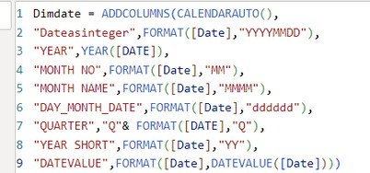

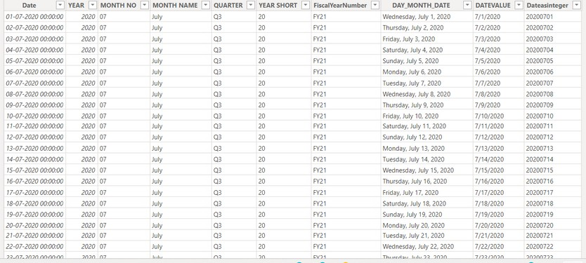

Visual Example for better understanding
You want to create a date dimension table (DimDate) with various calculated columns to make date-related analysis easier.
CALENDARAUTO():
Automatically creates a table with all dates in your data model. ADDCOLUMNS:
Adds new columns to this date table. New Columns:
Dateasinteger: Converts the date to YYYYMMDD format. YEAR: Extracts the year.
MONTH NO: Extracts the month number (01-12). MONTH NAME: Full month name (e.g., January).
DAY_MONTH_DATE: Full day name (e.g., Monday). QUARTER: Quarter of the year (e.g., Q1).
YEAR SHORT: Last two digits of the year (e.g., 24 for 2024). DATEVALUE: Serial number of the date.
Understood?

Slide 5
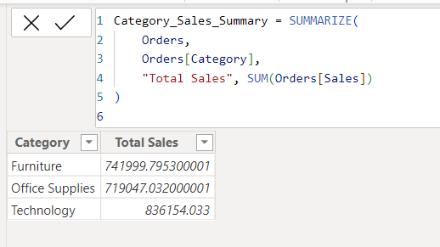
SUMMARIZE
SUMMARIZE groups data by one or more columns and can create additional columns with calculations based on these groups.
Check
next
Syntax
SUMMARIZE (<table>, <groupBy_columnName>[,
<groupBy_columnName>]…[, <name>, <expression>]…)
Example
You want to summarize the Orders table by Category and calculate the total sales for each category.
Here Create New Table
Orders is The table we are summarizing. Orders[Category] is The column we are grouping by (Category).
"Total Sales" is The name of the new column that will hold the summarized sales value.
SUM(Orders[Sales]) The expression to calculate the total sales for each category.

Slide 6
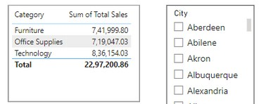
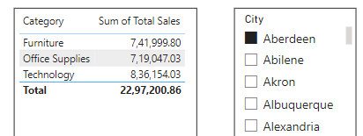
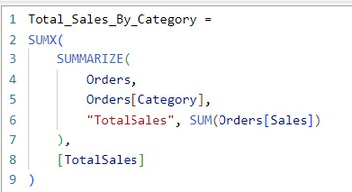
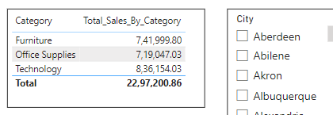
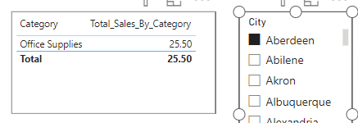
When you create a summary table using the SUMMARIZE function in DAX, the resulting table itself does not automatically interact with filters from other tables. However, the measures and visuals you create using this summary table can still interact with filters, provided the relationships in your data model are properly set up.
Understood?
You can use SUMMARIZE within another DAX function like SUMX to create a measure that interacts well with other table filters.
Let's continue with the same Orders table example to create a measure that calculates total sales by category and interacts with filters:
SUMMARIZE:Groups the Orders table by Category and calculates the sum of Sales for each category.
Creates a temporary table with columns Category and TotalSales.
SUMX:Iterates over the summarized table, and sums up the TotalSales values.

Slide 7


Thank you for joining me today to learn about Part -37 of Power BI!
Remember, Learning DAX is key to unlocking the full potential of Power BI for insightful reporting and visualization.
Stay tuned for more insights and tips on Power BI in our next Series.
Follow
Siddhika Shah

